Slide 1
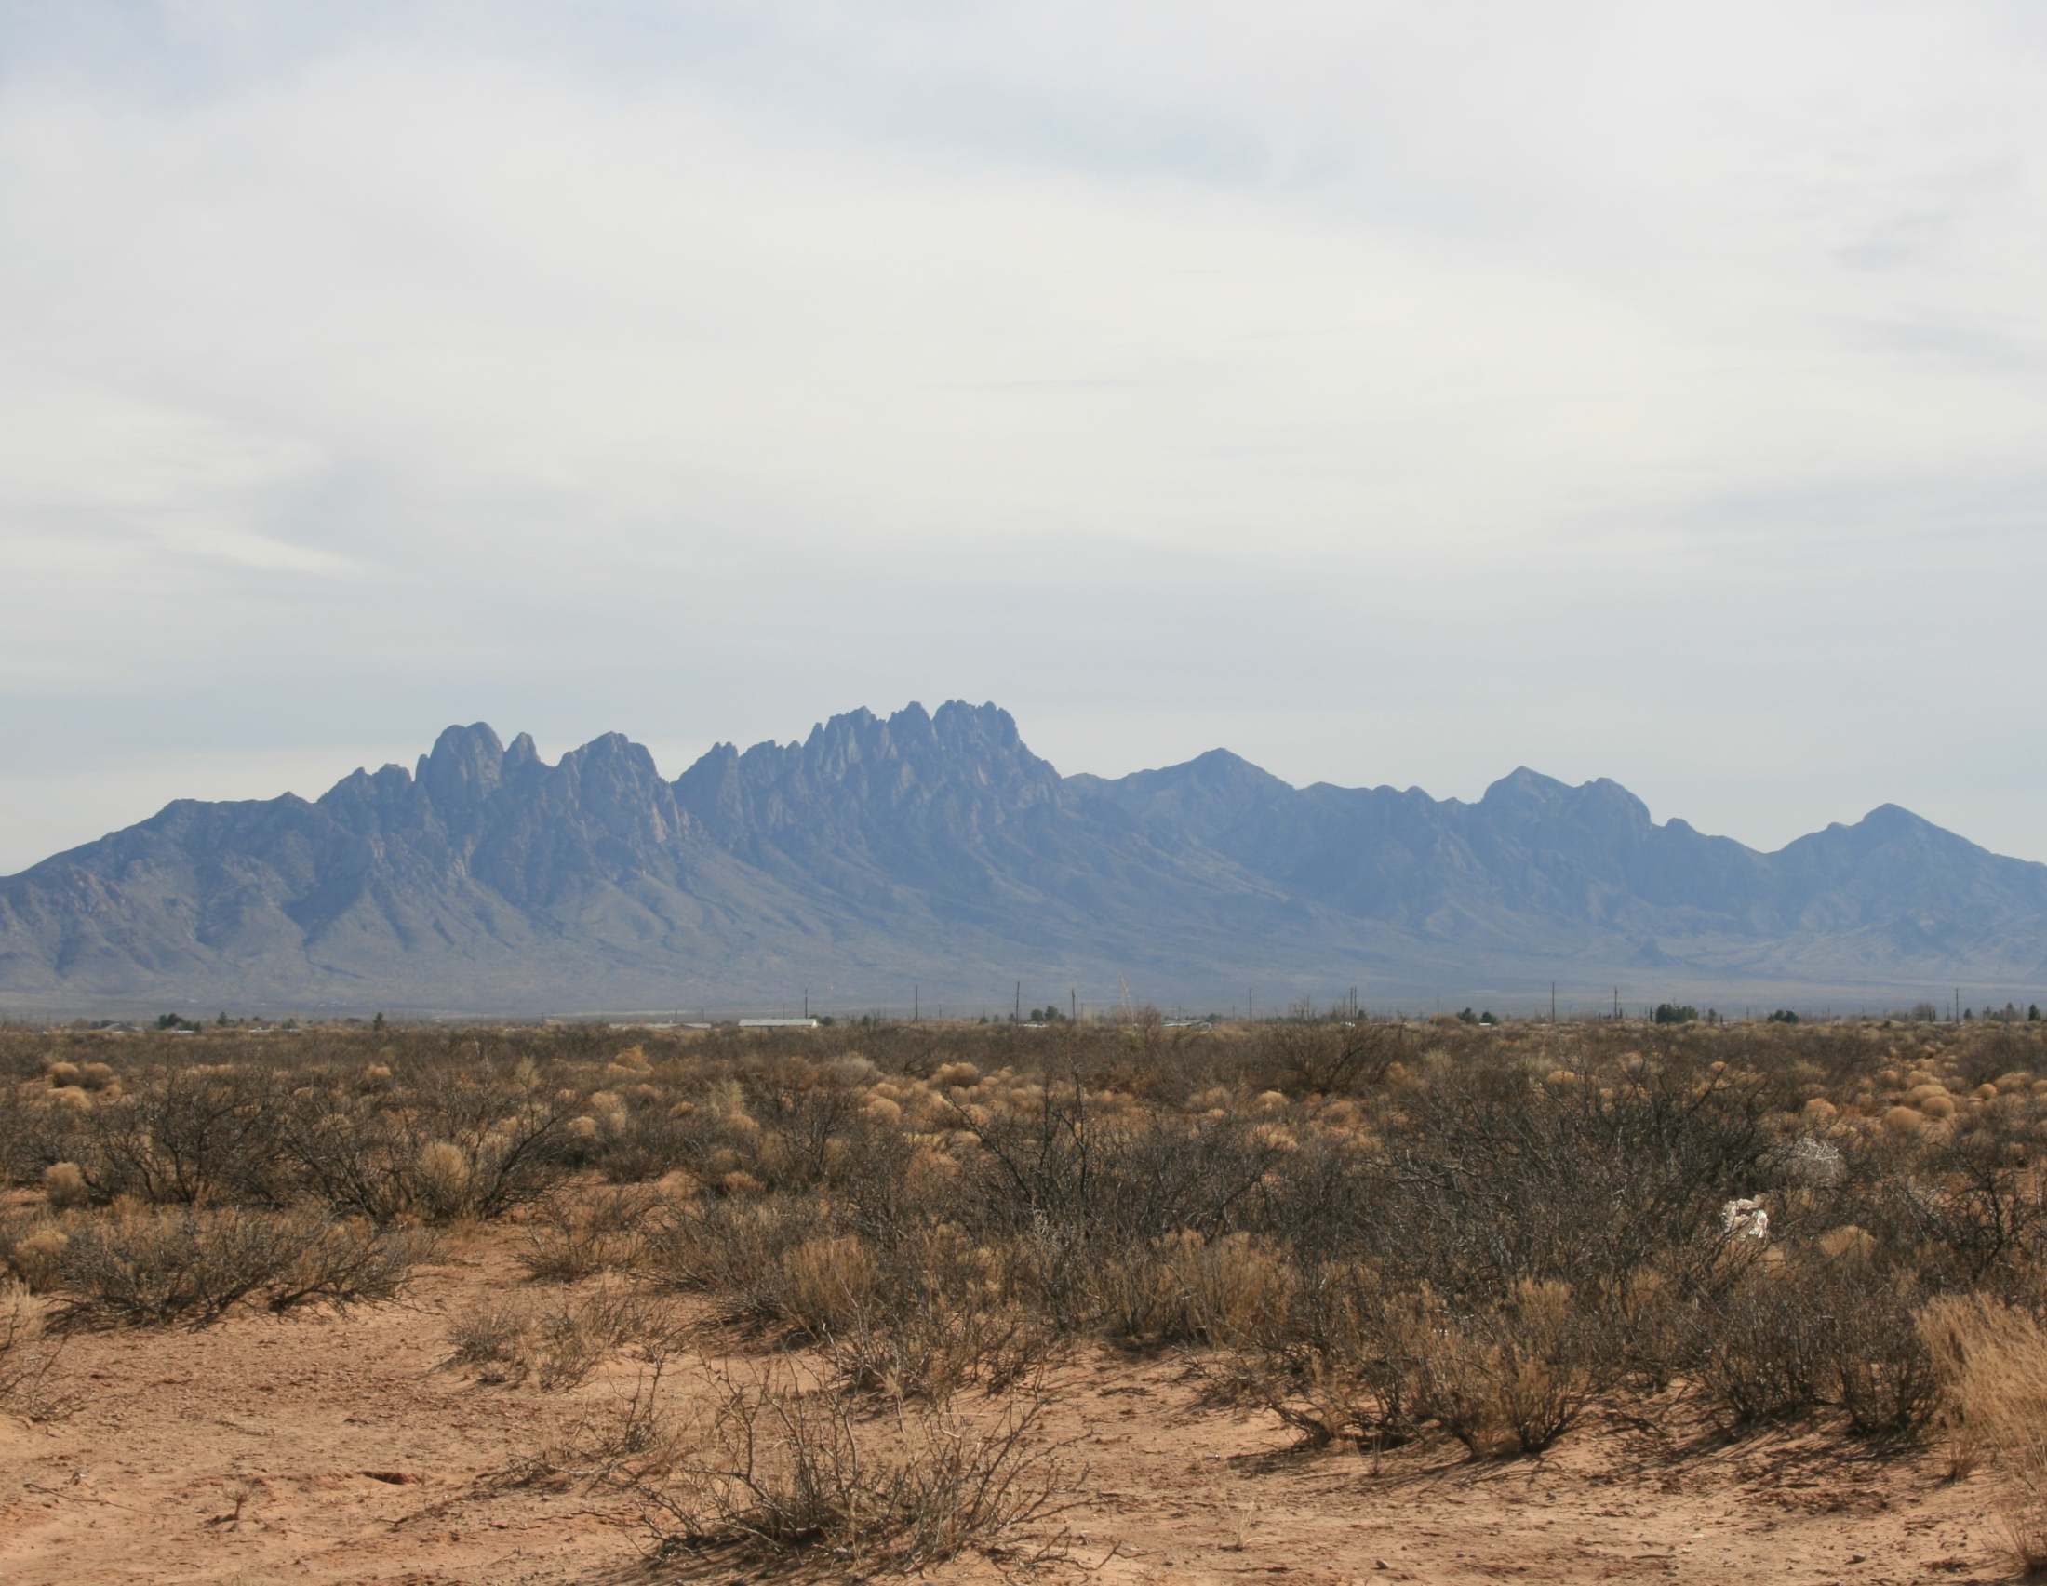
Statistics
(not the part with all the equations)

Slide 2
Overview
Statistics without equations?
Kinds of Data
How to summarize
Inference Space and Sampling
How to determine what that summary represents

Slide 3
Overview
Statistics without equations?
Kinds of Data
How to summarize
Inference Space and Sampling
How to determine what that summary represents

Slide 4
Overview
Statistics without equations?
Kinds of Data
How to summarize
Inference Space and Sampling
How to determine what that summary represents
I don’t expect you to know everything I cover today;
But, I do want you to think about how to use data:
Where did it come from?
What does it represent?
How can I use it (or not use it)?

Slide 5
Think about what you do with data
Storytime…………AR forest interps

Slide 6
Problems?
LONG | LAT | ACRES | SEEDLINGSU | MLRA | MUSYM | MUKEY | SeedMortal | AWC_0_6
-93.69299 | 33.09362 | 60 | 60 | 133B | 1 | 564881 | High | 0.2
-93.87277 | 33.20831 | 70 | 70 | 133B | 82 | 564961 | High | 0.2
-93.92391 | 33.27395 | 27 | 27 | 133B | 2 | 564892 | High | 0.2
-93.94135 | 33.61500 | 40 | 40 | 135B | 82 | 564961 | High | 0.2
-94.08030 | 33.73043 | 35 | 35 | 135B | 29 | 564902 | High | 0.2
-94.15653 | 33.74911 | 50 | 50 | 135B | 29 | 564902 | High | 0.2
-94.34380 | 33.79173 | 20 | 20 | 135B | 2 | 564892 | High | 0.2
-93.17249 | 33.16598 | 24 | 24 | 133B | 28 | 565364 | High | 0.1
-93.45277 | 33.22083 | 40 | 40 | 133B | 1 | 565344 | High | 0.2
-93.28423 | 33.27211 | 37 | 37 | 133B | 16 | 565351 | High | 0.2
-93.28423 | 33.27211 | 10 | 10 | 133B | 16 | 565351 | High | 0.2
-93.43333 | 33.33333 | 28 | 28 | 133B | 29 | 564902 | High | 0.2
-93.34115 | 33.34302 | 92 | 92 | 133B | 2 | 565355 | High | 0.2
-93.43337 | 33.34658 | 40 | 40 | 133B | 29 | 564902 | High | 0.2
-93.50000 | 33.35000 | 14 | 14 | 133B | 82 | 564961 | High | 0.2

Slide 7
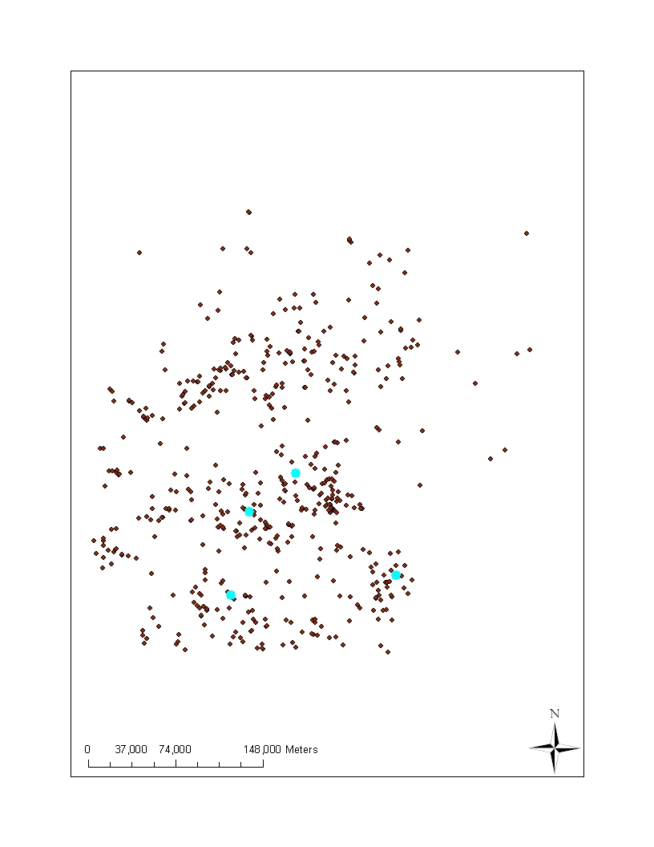
Problems?
LONG | LAT | ACRES | SEEDLINGSU | MLRA | MUSYM | MUKEY | SeedMortal | AWC_0_6
-93.69299 | 33.09362 | 60 | 60 | 133B | 1 | 564881 | High | 0.2
-93.87277 | 33.20831 | 70 | 70 | 133B | 82 | 564961 | High | 0.2
-93.92391 | 33.27395 | 27 | 27 | 133B | 2 | 564892 | High | 0.2
-93.94135 | 33.61500 | 40 | 40 | 135B | 82 | 564961 | High | 0.2
-94.08030 | 33.73043 | 35 | 35 | 135B | 29 | 564902 | High | 0.2
-94.15653 | 33.74911 | 50 | 50 | 135B | 29 | 564902 | High | 0.2
-94.34380 | 33.79173 | 20 | 20 | 135B | 2 | 564892 | High | 0.2
-93.17249 | 33.16598 | 24 | 24 | 133B | 28 | 565364 | High | 0.1
-93.45277 | 33.22083 | 40 | 40 | 133B | 1 | 565344 | High | 0.2
-93.28423 | 33.27211 | 37 | 37 | 133B | 16 | 565351 | High | 0.2
-93.28423 | 33.27211 | 10 | 10 | 133B | 16 | 565351 | High | 0.2
-93.43333 | 33.33333 | 28 | 28 | 133B | 29 | 564902 | High | 0.2
-93.34115 | 33.34302 | 92 | 92 | 133B | 2 | 565355 | High | 0.2
-93.43337 | 33.34658 | 40 | 40 | 133B | 29 | 564902 | High | 0.2
-93.50000 | 33.35000 | 14 | 14 | 133B | 82 | 564961 | High | 0.2

Slide 8
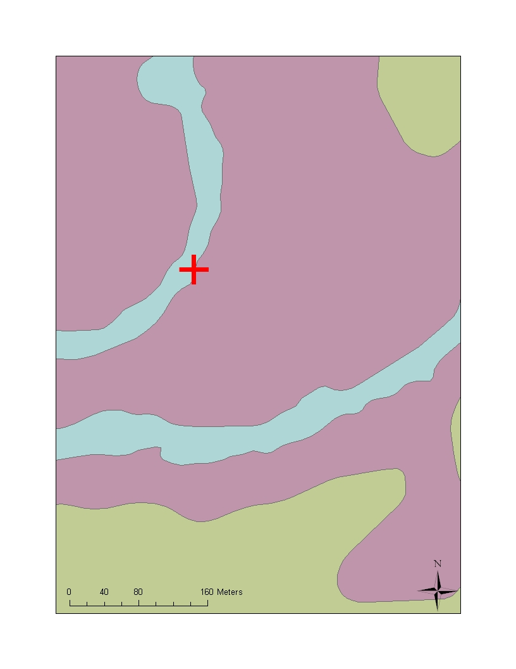
Problems
LONG | LAT | ACRES | Survival% | MUname
-93.69299 | 33.09362 | 60 | 100 | Acadia silt loam, 0 to 2 percent slopes
-93.87277 | 33.20831 | 70 | 84 | Wrightsville silt loam, 0 to 1 percent slopes
-93.92391 | 33.27395 | 27 | 95 | Adaton silt loam, 0 to 1 percent slopes
-93.94135 | 33.61500 | 40 | 55 | Wrightsville silt loam, 0 to 1 percent slopes
-94.08030 | 33.73043 | 35 | 70 | Guyton silt loam, frequently flooded
-94.15653 | 33.74911 | 50 | 44 | Guyton silt loam, frequently flooded
-94.34380 | 33.79173 | 20 | 70 | Adaton silt loam, 0 to 1 percent slopes
-93.17249 | 33.16598 | 24 | 98 | Smithton fine sandy loam, 0 to 2 percent slopes
-93.45277 | 33.22083 | 40 | 84 | Adaton-Felker association, 0 to 2 percent slopes
-93.28423 | 33.27211 | 37 | 55 | Guyton silt loam, frequently flooded
-93.28423 | 33.27211 | 10 | 86 | Guyton silt loam, frequently flooded
-93.43333 | 33.33333 | 28 | 28 | Guyton silt loam, frequently flooded
-93.34115 | 33.34302 | 92 | 60 | Amy silt loam, 0 to 1 percent slopes
-93.43337 | 33.34658 | 40 | 70 | Guyton silt loam, frequently flooded
-93.5 | 33.35 | 14 | 97 | Water

Slide 9
Statistics
2 parts
Philosophical and Common Sense
How do you conduct a study?
Framing hypotheses
What are your assumptions
Sampling and inference
Equations, algorithms etc.
Necessary to obtain measures and tests
Many programs that allow you to “push a button”
Notes:
You don’t have to remember everything in the this powerpoint, however, you do need to think about these issues when analyzing any dataset.

Slide 10
Statistics
2 parts
Philosophical and Common Sense
How do you conduct a study?
Framing hypotheses
What are your assumptions
Sampling and inference
Equations, algorithms etc.
Necessary to obtain measures and tests
Many programs that allow you to “push a button”
An expert (you) with the study subject must be involved in this part. We’ll come back to this .
The key is to know what “buttons” to push
Notes:
You don’t have to remember everything in the this powerpoint, however, you do need to think about these issues when analyzing any dataset.

Slide 11
Three kinds of data
We’ll talk about some examples
We’ll apply the ideas to soil information.
No
math
Most
math
NOMINAL
ORDINAL
CONTINUOUS
Notes:
Nominal – names or classes
Ordinal – numbers or letters that can be ranked
Continuous – numbers that are continuous from zero

Slide 12
Height
How do we summarize this?
Statistically
Average
Mean
Median
Mode
What type of data is it?
Use histograms to determine which is most appropriate
Student | Height (in) | Student | Height (in)
1 | 68 | 13 | 77
2 | 68 | 14 | 67
3 | 60 | 15 | 62
4 | 59 | 16 | 77
5 | 62 | 17 | 69
6 | 70 | 18 | 65
7 | 68 | 19 | 64
8 | 71 | 20 | 66
9 | 75 | 21 | 67
10 | 67 | 22 | 70
11 | 63 | 23 | 72
12 | 62 | 24 | 71

Slide 13
Histogram: a graphical display of frequencies
Count or frequency: the number of times
values fell within each bin.
Range of values called “bins”.

Slide 14
How would I summarize height?
Average –
Usually arithmetic mean (add all values and divide by the number of values)
Student | Height | Student | Height
1 | 68 | 13 | 77
2 | 68 | 14 | 67
3 | 60 | 15 | 62
4 | 59 | 16 | 77
5 | 62 | 17 | 69
6 | 70 | 18 | 65
7 | 68 | 19 | 64
8 | 71 | 20 | 66
9 | 75 | 21 | 67
10 | 67 | 22 | 70
11 | 63 | 23 | 72
12 | 62 | 24 | 71
Average = 67.6
Notes:
Average is a fuzzy term, google “average vs. mean” and you’ll see what I mean. Most people use average to mean arithmetic mean – but it can also mean any value that represents the central tendency of a dataset, sample or population.

Slide 15
Height
Height is an example of continuous data. They are numbers that can be mathematically combined and fractions or decimals make some sense.
Means are usually a good way to summarize this kind of data
Student | Height | Student | Height
1 | 68 | 13 | 77
2 | 68 | 14 | 67
3 | 60 | 15 | 62
4 | 59 | 16 | 77
5 | 62 | 17 | 69
6 | 70 | 18 | 65
7 | 68 | 19 | 64
8 | 71 | 20 | 66
9 | 75 | 21 | 67
10 | 67 | 22 | 70
11 | 63 | 23 | 72
12 | 62 | 24 | 71

Slide 16
When does an mean not work for continuous data?
When the distribution is skewed or has a “tail”
Median
The middle of the distribution
mean | 79.5
median | 81.0
mode | 83.0
Median: 81.0
Average: 79.5
Notes:
The median has the same number of values above and below it. To get the median, list all the values from lowest to highest, the one in the middle is the median.

Slide 17
When does an mean not work for continuous data?
When you are really looking at more than one condition or population.
Average Women
Average Men
Average: 67.4

Slide 18
Other kinds of data
Did you groan, grimace or curse when you saw the word “statistics” on the agenda?
Yes or No

Slide 19
Reaction to “statistics” on the agenda
How do we summarize this information?

Slide 20
Can’t take an arithmetic mean of the response:
This is called nominal data: text, words or labels not usually numbers
Mode
The value that has the largest number of observations
Mode: No

Slide 21
Other kinds of data
In which month were you born?

Slide 22
What kind of data are months?

Slide 23
We can change months to numeric values
This is called ordinal data – numbers…with restrictions
mean | 7
median | 7
mode | 7
Notes:
Ordinal values have a rank but no true zero. January always come before February. Often the distance between values isn’t constant (January has 31 days, but February has 28). Therefore, 7.2 doesn’t have real meaning.

Slide 24
We can change months to numeric values
This is called ordinal data – numbers…with restrictions
mean | 7
median | 7
mode | 7
We can calculate an average but we must be careful. fractions and decimals don’t make sense with ordinal values
Mean = 7.24
7.24 = July 7, 5 am
Notes:
Ordinal values have a rank but no true zero. January always come before February. Often the distance between values isn’t constant (January has 31 days, but February has 28). Therefore, 7.2 doesn’t have real meaning.

Slide 25
Three kinds of data
more
math
No
math
NOMINAL
ORDINAL
CONTINUOUS
Notes:
Nominal – names or classes
Ordinal – numbers or letters that can be ranked
Continuous – numbers that are continuous from zero

Slide 26
What kind of data are these? fill out your worksheet
Nominal | Ordinal | Continuous
Classification
Color –
value/chroma
Color - hue
Structure – grade,
Structure –
size measurement
Structure - type
size class
Diagnostic horizon
- type
Diagnostic horizon
- thickness
% clay content
texture
Most lab data

Slide 27
What are mean, median and mode used to populate?

Slide 28
More than RV
Range
Low and high
Standard Deviation
Statistical measure (calculates the measure of the variability or dispersion)
Confidence Interval
Statistical measure of the certainty of the estimation of the mean
Notes:
Standard deviation is a property of the population (you don’t expect it to change dramatically as you collect more samples)
Confidence intervals are a property of the sample (this means increasing the number of samples will increase your certainty or shrink the confidence interval).

Slide 29
Range
Usually simple: max and min
Student | Height (in) | Student | Height (in)
1 | 68 | 13 | 77
2 | 68 | 14 | 67
3 | 60 | 15 | 62
4 | 59 | 16 | 77
5 | 62 | 17 | 69
6 | 70 | 18 | 65
7 | 68 | 19 | 64
8 | 71 | 20 | 66
9 | 75 | 21 | 67
10 | 67 | 22 | 70
11 | 63 | 23 | 72
12 | 62 | 24 | 71
Low | 59
High | 77

Slide 30
Which properties on you list can you create a range for?
Nominal | Ordinal | Continuous
texture
Classification
Color –
value/chroma
Color - hue
Structure – grade,
Structure –
size measurement
Structure - type
size class
Diagnostic horizon
- type
Diagnostic horizon
- thickness
Most lab data
texture

Slide 31
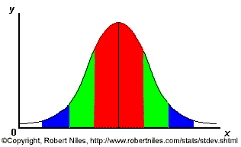
Red – 1 stdev (expect 68% within)
Green – 2 stdev (expect 95% within)
Blue – 3 stdev (expect 68% of samples)
Taken from RoberNiles.com
Notes:
Its expected that 68% of the samples will fall within one standard deviation (the red), 95 % within 2 standard deviations (red and greed) and 99% will fall within 3 std deviations (red, green and blue).

Slide 32
mean | 67.6
median | 67.5
mode | 68.0
Std. dev. | 4.84
Mean
2 stdev
1 stdev
60 65 67 70 75

Slide 33
mean | 78.3
median | 80.1
mode | 83.0
Std. dev. | 5.7
Mean
2 stdev
1 stdev

Slide 34
mean | 78.3
median | 80.1
mode | 83.0
Std. dev. | 5.7
Outlier: an observation that is numerically distant from the rest of the data
Mean
3 stdev
2 stdev
1 stdev
Notes:
A value that is far outside of the rest of the values is called an outlier.

Slide 35
Outliers can occur for many reasons.
That observation is outside of the population
Measurement error
median
not
mean
How do you deal with an outlier?
Remove it from the analysis
Use appropriate stats for a skewed distribution

Slide 36
Which properties on your list can you calculate a standard deviation for?
Nominal | Ordinal | Continuous
texture
Classification
Color –
value/chroma
Color - hue
Structure – grade,
Structure –
size measurement
Structure - type
size class
Diagnostic horizon
- type
Diagnostic horizon
- thickness
Most lab data

Slide 37
Confidence Interval
Gives a range of likely values
Depends of the confidence limit
Usually expressed as a %
For example – I am 80% certain that the class average was between 94 - 97 pts
The confidence interval changes based on the standard deviation, the number of samples and the confidence limit

Slide 38
Mean | 67.6
Std. dev. | 4.84
CI (80%) | 66.3 – 68.8
CI (90%) | 66.0 – 69.1
CI (99%) | 65.1 – 70.1
Mean
99% CI
80% CI
60 65 67 70 75
Notes:
CI and CL can be confusing. The higher the CL, the wider the CI
Alpha = 1 – the confidence limit
CI = t* x std dev/sqrt(N-1)
Get t from a standard table
t* = students t with alpha/2 and N-1 degrees of table

Slide 39
Mean | 70.9
Std. dev. | 10.5
CI (80%)
CI (99%)

Slide 40
Mean | 70.9
Std. dev. | 10.5
CI (80%) | 67.5 - 74.4
CI (90%) | 66.5 - 75.4
CI (95%) | 65.6 - 76.3
CI (99%) | 64.0 - 77.9

Slide 41
Mean + t*StdDev / n-1
N – number of samples
* where t* is the upper (1-C)/2 critical value for the t distribution with n-1 degrees of freedom, t(n-1)

Slide 42
Population
The thing we are interested in
The complete collection of observations we want to study
How would we define the population of a soil?
Notes:
Taxonomically is one way, Geographically might be another. Components are used to aggregate information in NASIS.

Slide 43
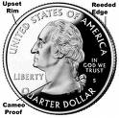
How do we say things about a population?
Sampling
Inference
Notes:
We’ll start by thinking about sampling – which is a little more straightfoward. The next 5 slide are about idealized sampling – this is not done very often by soil survey; but it will help us to think about the ideal before we turn it around and apply the results of samples we already have.

Slide 44
Sample
A subset of a population
Sampling unit (one sample) - The thing we actually observe or collect
Assuming our population of interest is our class: How would you sample your class to get representative data?
Cluster
– by groups
Randomly
Systematically
Notes:
The simplest way to sample is randomly – draw names out of a hat.
Assuming, you were randomly assigned to groups. We could quiz one group and get a reasonable representation of the entire class.
Systematically - list names in alphabetical order and systematically (for example, every fifth name) select a sample (this assumes that there is no relationship between the alphabetical rank and the thing we’re interested in).

Slide 45
Sample
A subset of a population
How would you sample a soil?
Randomly
Select random
x–y points within the polygon
Systematically
Select points on a 20m grid
Cluster
randomly select areas then collect multiple samples within that area
Notes:
The simplest way to sample is randomly – draw names out of a hat.
Assuming you were randomly assigned to groups, we could quiz one group and get a reasonable representation of the entire class.
Systematically - list names in alphabetical order and systematically (for example, every fifth name) select a sample (this assumes that there is no relationship between the alphabetical rank and the thing we’re interested in).

Slide 46
Randomly

Slide 47
Randomly: Stratified Random
Notes:
Stratified random – select one random person from each group. This would be ideal if there was some relatipnship between group and the thing we’re measuring. In soil survey, it can be used to break the landscape into segments and then randomly selects a point within each. The maintain randomness (unbiadness) but ensures that samples are spread out over the landscape. Stratification can be used to choose polygons and/or to choose points within a polygon.

Slide 48
Systematic: Regular Grid
Notes:
For our class, we could select every fifth or fourth person. On the landscape, this could take the form of a grid.

Slide 49
Systematic: Transect
Notes:
Transects are a type of systematic sample. The difficulty with transects is selecting a distance that captures the variability present and does not miss things that occur in a repeating pattern.

Slide 50
Clusters
Notes:
A cluster is any sampling scheme that concentrates sampling geographically. Within a cluster, samples can be collected systematically (1), or randomly (2 and 3).

Slide 51
Why do I keep using the word random?
Bias: tendancy or preference that interferes with the ability to be impartial or objective
randomness avoids bias
Examples of Bias in soil sampling..?
taking all your samples no more than 10 feet from a road.
Notes:
Standard statistical tests are based on an assumption that samples are randomly drawn from a population.

Slide 52
A note on bias
Bias isn’t all bad
When we direct samples to an area to capture the variability
This is model directed sampling
However……….. we need to be careful, documenting the how and why
GIS can help with this a lot
How representative is that area you directed your sampling towards
Notes:
Your conceptual model of soil formation and soil property distribution is used to direct sampling.

Slide 53
Polygon A
Transects
Polygon C
Polygon B
Notes:
Collecting samples on multiple delineations is are an example of cluster sampling. Systematic (transects) or random samples could be used.

Slide 54
Polygon - transect | Sample | % Clay
A | 1 | 20
 | 2 | 22
 | 3 | 17
B | 1 | 28
 | 2 | 23
 | 3 | 24
 | 4 | 25
 | 5 | 16
C | 1 | 21
 | 2 | 22
 | 3 | 20
 | 4 | 23
 | 5 | 18

Slide 55
Polygon - transect | Sample | % Clay | Overall Mean
A | 1 | 20
 | 2 | 22
 | 3 | 17
B | 1 | 28
 | 2 | 23
 | 3 | 24
 | 4 | 25
 | 5 | 16
C | 1 | 21
 | 2 | 22
 | 3 | 20
 | 4 | 23
 | 5 | 18
 |  |  | 22

Slide 56
Polygon - transect | Sample | % Clay | Overall Mean | Polygon Mean
A | 1 | 20 |  | 20
 | 2 | 22
 | 3 | 17
B | 1 | 28 |  | 23
 | 2 | 23
 | 3 | 24
 | 4 | 25
 | 5 | 16
C | 1 | 21 |  | 19
 | 2 | 22
 | 3 | 20
 | 4 | 23
 | 5 | 18
 |  |  | 22 | 21
Notes:
Considering transects as a cluster

Slide 57
Weighted Mean
3 transects
A – 3 obvservations – 21%
B – 20 observations – 33%
C – 10 observations – 26%
Typical mean = 26
Is this representative?
Weighted Average

Slide 58
Weighted Mean
3 transects - % of observed area
A – 5 ac – 6%
B – 60 ac – 67%
C – 25 ac – 28%
Weighted mean = 31
(21 * 5/90)
(33 * 60/90)
(26 * 25/90)
(21 * 0.06)+(33 * 0.67)+(26 *0.28)
= 31

Slide 59
Weighted Mean
The way you calculate the mean depends on how your polygons were selected and how representative they are: expert opinion…
3 transects
A – 25 ac – 21%
B – 300 ac – 33%
C – 75 ac – 26%
Weighted mean = 31

Slide 60
Weighted Mean
Cluster (mean of means) – random sample represent all polygons
-- are randomly or thoughtfully selected to be representative
3 transects
A – 25 ac – 21%
B – 300 ac – 33%
C – 75 ac – 26%
Weighted mean = 31
Weighted Avg – Use when sample is biased or uneven (because of access or other issues)
Notes:
You could use a simple average IF – you used the same number of samples on all polygons AND your polygons are representative

Slide 61
Weighted Mean
You can use a simple average…
IF
you used the same number samples in each transect
AND
The polygons chosen are representative
3 transects
A – 25 ac – 21%
B – 300 ac – 33%
C – 75 ac – 26%
Weighted mean = 31

Slide 62
The other side of the coin
Inference
Sampling

Slide 63
Inference Space
The conceptual space (or population) to which the results of a study can be applied (or the population to which statistical inferences can be made)
What will the inference space of our class height be?
Notes:
Do they apply to the entire building? All soil scientists? The city of Lincoln? The entire country, or some smaller demographic.

Slide 64
Why do we care?
We want to be right
Match data to the appropriate soils or conditions
We want to be efficient
We have limited resources
Notes:
Thinking about sampling and inference is a natural extension of thinking about soils and map units. In order to properly gather data, or apply data we already have – we need to think about sampling and inference.

Slide 65
Why do we care?
Sampling and Inference Space go hand in hand:
You need to sample an area
Where do you sample to ensure that it represents an area or condition well?
You may already have samples
What do the properties of those samples represent?

Slide 66
Inference Space: entire neighborhood
Example: a neighborhood with 4 yards
Inference Space: Yards C and D
Inference Space: Yard A
Yard A
Yard B
Yard C
Yard D
Notes:
Yards are similar to management systems or treatments, but conceptually they could be any feature that seperates the world into populations.

Slide 67
Inference Space
Statistically – you can only make an inference from a sampled population
Defining the population is important and involves considered expert opinions of the scientists involved
Yard A
Yard B
Yard C
Yard D

Slide 68
Inference Space
Statistically – you can only make an inference from a sampled population
Defining the population is important and involves considered expert opinions of the scientists involved
Are yards a good way to define this population?
Yards likely account for management differences.
Yard A
Yard B
What don’t they account for?
Yard C
Yard D

Slide 69
Inference Space
Statistically – you can only make an inference from a sampled population
Ideally statistically valid samples should be selected randomly (there are many techniques for doing this, we discussed some)
Is this how most soils are sampled for NRCS?

Slide 70
Inference Space
Is this how most soils are sampled for NRCS?
Statistically – you can only make an inference from a sampled population
Ideally statistically valid samples should be selected randomly (there are many techniques for doing this)
Typically, we use our soil forming model to determine where to sample. (sometimes called purposive sampling)
We need to think about how samples were selected and what that means.

Slide 71
Inference Space
Is this how most soils are sampled for NRCS?
Statistically – you can only make an inference from a sampled population
Ideally statistically valid samples should be selected randomly (there are many techniques for doing this)
Model directed sampling
What was your sampling model?
Is it documented?
Can someone else understand what you did and why?
Typically, we use our soil forming model to determine where to sample. (sometimes called purposive sampling)
This serves us well for mapping, but when we’re using the data for other purposes we need to think about how samples were selected and what that means.

Slide 72
Yard A
Yard B
Gamma
Alpha
Yard C
Yard D
Beta
Notes:
Add a soil map to our fictional yards. How well are our original samples likely to apply?

Slide 73
Now with expert knowledge we’ll reevaluate inference space for the yard C and D samples.
Yard A
Yard B
Gamma
Alpha
Yard C
Yard D
Beta
What is the inference space?
Where do the results of the analyses apply?
Notes:
The answer to these questions will depend on the differences in management between the yards AND the differences in the soil map units.

Slide 74
Inference Space
Pragmatically – you can argue for an expansion of the inference space through expert knowledge
Existing soil maps or models
Yard A
Yard B
Gamma
Alpha
Yard C
Yard D
Beta

Slide 75
Inference Space
Pragmatically – you can argue for an expansion of the inference space through expert knowledge
Existing soil maps or models
You are the expert: use available information and your knowledge of the distribution of soils to determine:
what portion of the landscape any given set of samples represents
Where do I need to sample to have representative knowledge of the area
Yard A
Yard B
Gamma
Alpha
Yard C
Yard D
Beta

Slide 76
Questions?

Slide 77
Class Height

Slide 78
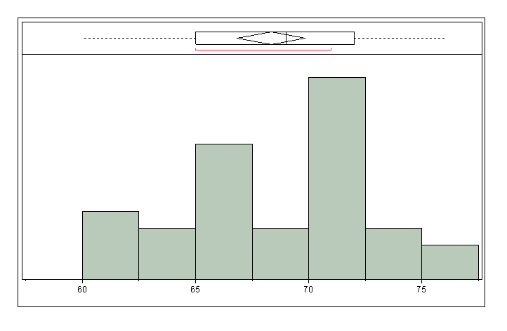
Mean 68.3
Std Dev 4.38
Std Err Mean 0.7
Upper 95% Mean 69.8
Lower 95% Mean 66.8
N 35
Median - 69
Notes:
The distribution isn’t perfectly normal (not a perfect bell curve) but it’s close enough.

Slide 79
Mean 68.3
Std Dev 4.38
Std Err Mean 0.7
Upper 95% Mean 69.8
Lower 95% Mean 66.8
N 35

Slide 80
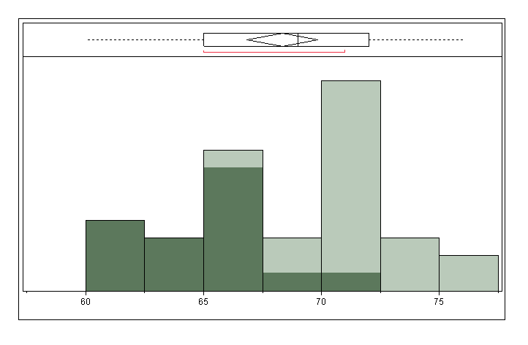

Slide 81
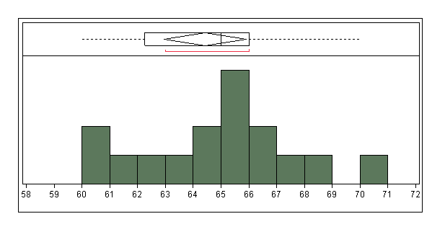
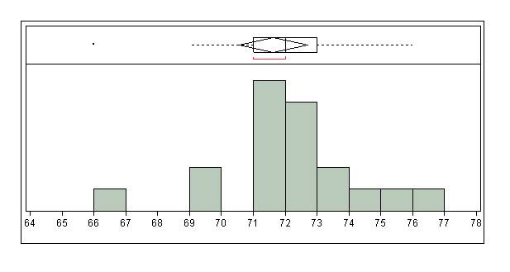

Slide 82
Female
Average | 64.4
Median | 65
Std dev | 2.8
Male
Average | 71.6
Median | 72
Std dev | 2.2

Slide 83
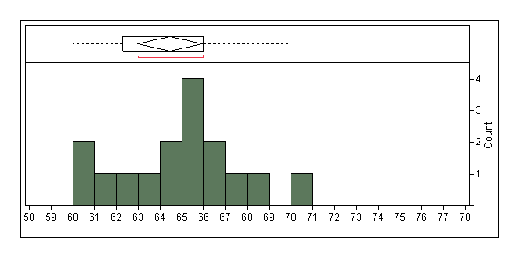
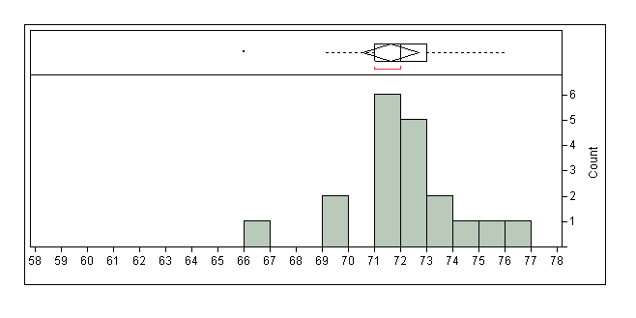
Female
Average | 64.4
Median | 65
Std dev | 2.8
Male
Average | 71.6
Median | 72
Std dev | 2.2
Notes:
Male and female heights overlap, but they are significantly different and do not appear to be part of the same population.

Slide 84
Female
Average | 64.4
Median | 65
Std dev | 2.8
Does this mean we should have separate classes?
No, height has nothing to do with class performance – keep that in mind when evaluating soil properties and populations.
Male
Average | 71.6
Median | 72
Std dev | 2.2
Notes:
Male and female heights overlap, but they are significantly different and do not appear to be part of the same population.

Slide 85
Sampling
How would we get a good sample from this class?

Slide 86
Random Sampling
Sampled - no. | height |  | Sample stats
random - 1st
18 | 72 |  | mean | 70
5 | 67 |  | stdev | 4.39
11 | 68
20 | 76 |  | median | 68
32 | 65
random - 2nd
29 | 65 |  | mean | 68
14 | 65 |  | stdev | 3.67
8 | 72
17 | 72 |  | median | 66
4 | 66
random-3rd
32 | 65 |  | mean | 68
28 | 71 |  | stdev | 3.42
8 | 72
32 | 65 |  | median | 66
27 | 66

Slide 87
Systematic Sampling
Sampled - no. | height |  | Sample stats
Every 5th - start on 5
5 | 66 |  | mean | 70
10 | 66 |  | stdev | 4.18
15 | 71
20 | 76 |  | median | 71
25 | 71
Every 4th - start on 2
2 | 73 |  | mean | 67
6 | 69 |  | stdev | 3.94
10 | 66
14 | 65 |  | median | 65.5
18 | 62
22 | 64

Slide 88
Cluster Sampling
Sampled - no. | height |  | Sample stats
1 Group - group 5
25 | 73 |  | mean | 69.7
26 | 72 |  | stdev | 3.3
27 | 66
28 | 71 |  | median | 71.0
29 | 65
30 | 71
2 Groups - 5 and 2
7 | 69 | group |  |  | mean | 69
8 | 72 | mean | 68.0 |  | stdev | 1.18
9 | 65
10 | 66 |  |  |  | median | 69
11 | 68
12 | 70 | group
25 | 73 | mean | 69.7
26 | 71
27 | 72
28 | 66
29 | 71
30 | 65

Slide 89
What is our class RV?
Mean = 68

